Slide 1

Transport Protocols Reading: Sections 2.5, 5.1, and 5.2
COS 461: Computer Networks
Spring 2006 (MW 1:30-2:50 in Friend 109)
Jennifer Rexford
Teaching Assistant: Mike Wawrzoniak
http://www.cs.princeton.edu/courses/archive/spring06/cos461/

Slide 2
Role of Transport Layer
Application layer
Communication for specific applications
E.g., HyperText Transfer Protocol (HTTP), File Transfer Protocol (FTP), Network News Transfer Protocol (NNTP)
Transport layer
Communication between processes (e.g., socket)
Relies on network layer and serves the application layer
E.g., TCP and UDP
Network layer
Logical communication between nodes
Hides details of the link technology
E.g., IP

Slide 3






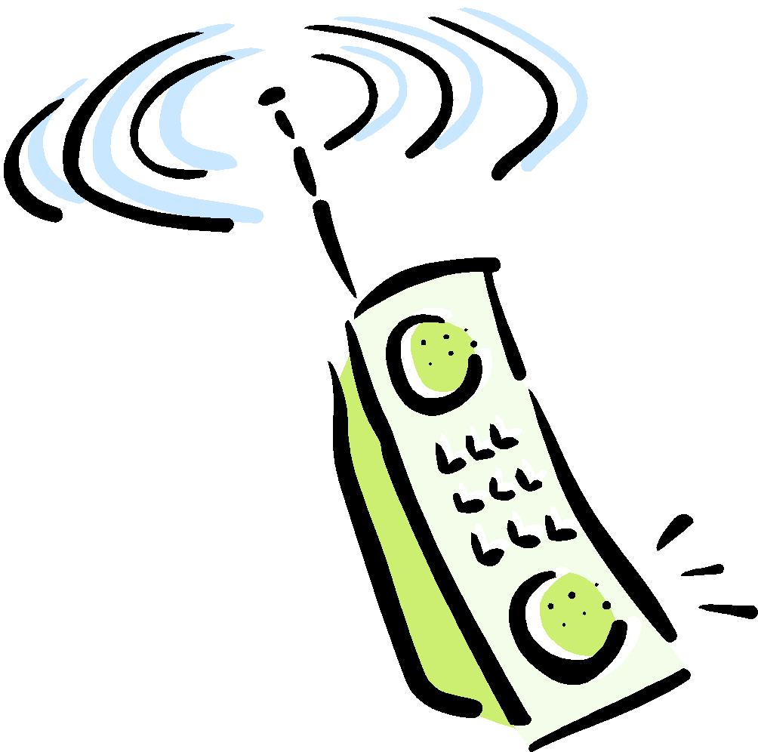
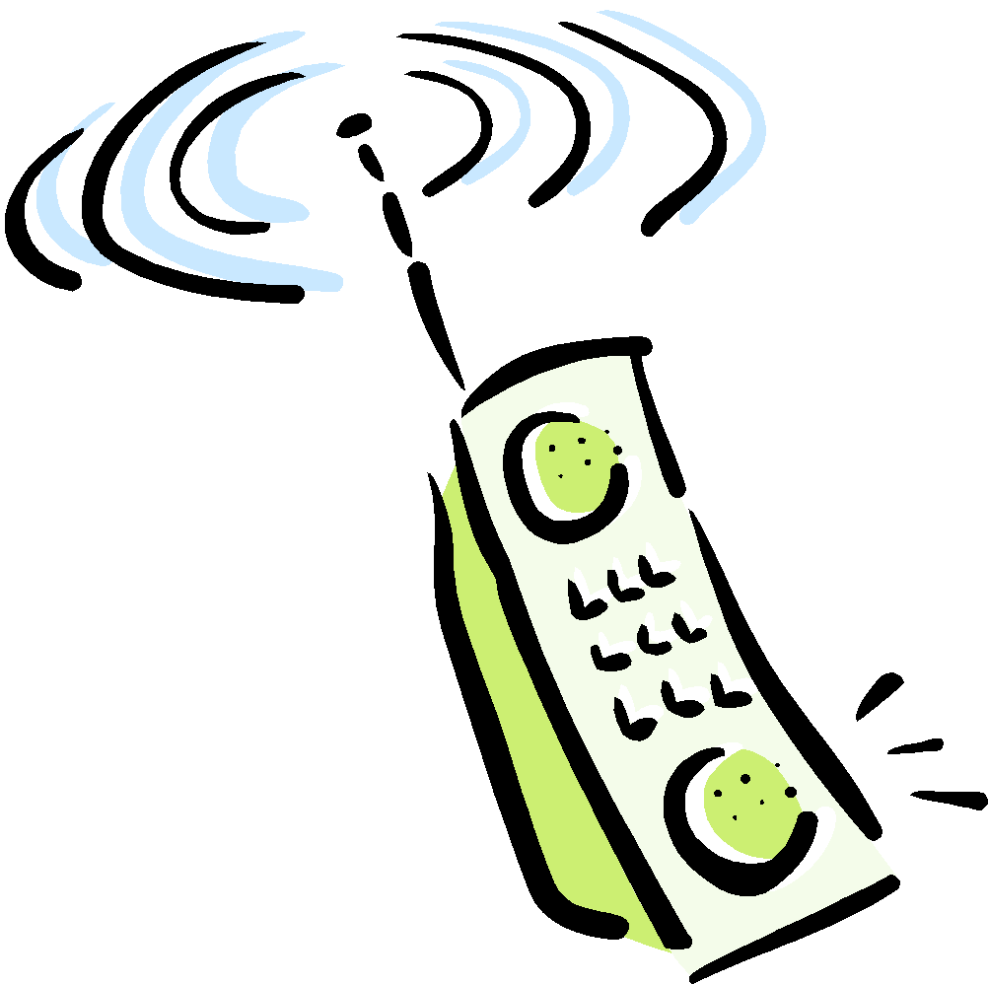

Transport Protocols
Provide logical communication between application processes running on different hosts
Run on end hosts
Sender: breaks application messages into segments, and passes to network layer
Receiver: reassembles segments into messages, passes to application layer
Multiple transport protocol available to applications
Internet: TCP and UDP
application
transport
network
data link
physical
network
data link
physical
network
data link
physical
network
data link
physical
logical end-end transport
network
data link
physical
network
data link
physical
application
transport
network
data link
physical

Slide 4
Internet Transport Protocols
Datagram messaging service (UDP)
No-frills extension of “best-effort” IP
Reliable, in-order delivery (TCP)
Connection set-up
Discarding of corrupted packets
Retransmission of lost packets
Flow control
Congestion control
Other services not available
Delay guarantees
Bandwidth guarantees

Slide 5
Multiplexing and Demultiplexing
Host receives IP datagrams
Each datagram has source and destination IP address,
Each datagram carries one transport-layer segment
Each segment has source and destination port number
Host uses IP addresses and port numbers to direct the segment to appropriate socket
32 bits
source port #
dest port #
other header fields
application
data
(message)
TCP/UDP segment format

Slide 6
Unreliable Message Delivery Service
Lightweight communication between processes
Avoid overhead and delays of ordered, reliable delivery
Send messages to and receive them from a socket
User Datagram Protocol (UDP)
IP plus port numbers to support (de)multiplexing
Optional error checking on the packet contents
SRC port
DST port
checksum
length
DATA

Slide 7
Why Would Anyone Use UDP?
Finer control over what data is sent and when
As soon as an application process writes into the socket
… UDP will package the data and send the packet
No delay for connection establishment
UDP just blasts away without any formal preliminaries
… which avoids introducing any unnecessary delays
No connection state
No allocation of buffers, parameters, sequence #s, etc.
… making it easier to handle many active clients at once
Small packet header overhead
UDP header is only eight-bytes long

Slide 8



Popular Applications That Use UDP
Multimedia streaming
Retransmitting lost/corrupted packets is not worthwhile
By the time the packet is retransmitted, it’s too late
E.g., telephone calls, video conferencing, gaming
Simple query protocols like Domain Name System
Overhead of connection establishment is overkill
Easier to have application retransmit if needed
“Address for www.cnn.com?”
“12.3.4.15”

Slide 9
Transmission Control Protocol (TCP)
Connection oriented
Explicit set-up and tear-down of TCP session
Stream-of-bytes service
Sends and receives a stream of bytes, not messages
Reliable, in-order delivery
Checksums to detect corrupted data
Acknowledgments & retransmissions for reliable delivery
Sequence numbers to detect losses and reorder data
Flow control
Prevent overflow of the receiver’s buffer space
Congestion control
Adapt to network congestion for the greater good

Slide 10
Challenges of Reliable Data Transfer
Over a perfectly reliable channel
All the data arrives in order, just as it was sent
Simple: sender sends data, and receiver receives data
Over a channel with bit errors
All the data arrives in order, but some bits corrupted
Receiver detects errors and says “please repeat that”
Sender retransmits the data that were corrupted
Over a lossy channel with bit errors
Some data are missing, and some bits are corrupted
Receiver detects errors but cannot always detect loss
Sender must wait for acknowledgment (“ACK” or “OK”)
… and retransmit data after some time if no ACK arrives

Slide 11
TCP Support for Reliable Delivery
Checksum
Used to detect corrupted data at the receiver
…leading the receiver to drop the packet
Sequence numbers
Used to detect missing data
... and for putting the data back in order
Retransmission
Sender retransmits lost or corrupted data
Timeout based on estimates of round-trip time
Fast retransmit algorithm for rapid retransmission

Slide 12
Sequence Numbers
Host A
ISN (initial sequence number)
Sequence number = 1st byte
TCP
HDR
TCP Data
ACK sequence number = next expected byte
TCP Data
TCP
HDR
Host B
Notes:
‹#›
*
*
*

Slide 13
Initial Sequence Number (ISN)
Sequence number for the very first byte
E.g., Why not a de facto ISN of 0?
Practical issue
IP addresses and port #s uniquely identify a connection
Eventually, though, these port #s do get used again
… and there is a chance an old packet is still in flight
… and might be associated with the new connection
So, TCP requires changing the ISN over time
Set from a 32-bit clock that ticks every 4 microseconds
… which only wraps around once every 4.55 hours!
But, this means the hosts need to exchange ISNs

Slide 14
TCP Three-Way Handshake

Slide 15
Establishing a TCP Connection
A
B
SYN
SYN ACK
Each host tells its ISN to the other host.
ACK
Data
Data
Three-way handshake to establish connection
Host A sends a SYN (open) to the host B
Host B returns a SYN acknowledgment (SYN ACK)
Host A sends an ACK to acknowledge the SYN ACK

Slide 16
TCP Header
Source port
Destination port
Sequence number
Flags:
SYN
FIN
RST
PSH
URG
ACK
Acknowledgment
HdrLen
0
Flags
Advertised window
Checksum
Urgent pointer
Options (variable)
Data

Slide 17
Step 1: A’s Initial SYN Packet
A’s port
B’s port
A’s Initial Sequence Number
Flags:
SYN
FIN
RST
PSH
URG
ACK
Acknowledgment
20
Flags
Advertised window
0
Checksum
Urgent pointer
Options (variable)
A tells B it wants to open a connection…

Slide 18
Step 2: B’s SYN-ACK Packet
B’s port
A’s port
B’s Initial Sequence Number
Flags:
SYN
FIN
RST
PSH
URG
ACK
A’s ISN plus 1
20
Flags
Advertised window
0
Checksum
Urgent pointer
Options (variable)
B tells A it accepts, and is ready to hear the next byte…
… upon receiving this packet, A can start sending data

Slide 19
Step 3: A’s ACK of the SYN-ACK
A’s port
B’s port
Sequence number
Flags:
SYN
FIN
RST
PSH
URG
ACK
B’s ISN plus 1
20
Flags
Advertised window
0
Checksum
Urgent pointer
Options (variable)
A tells B it wants is okay to start sending
… upon receiving this packet, B can start sending data

Slide 20
What if the SYN Packet Gets Lost?
Suppose the SYN packet gets lost
Packet is lost inside the network, or
Server rejects the packet (e.g., listen queue is full)
Eventually, no SYN-ACK arrives
Sender sets a timer and wait for the SYN-ACK
… and retransmits the SYN-ACK if needed
How should the TCP sender set the timer?
Sender has no idea how far away the receiver is
Hard to guess a reasonable length of time to wait
Some TCPs use a default of 3 or 6 seconds

Slide 21
SYN Loss and Web Downloads
User clicks on a hypertext link
Browser creates a socket and does a “connect”
The “connect” triggers the OS to transmit a SYN
If the SYN is lost…
The 3-6 seconds of delay may be very long
The user may get impatient
… and click the hyperlink again, or click “reload”
User triggers an “abort” of the “connect”
Browser creates a new socket and does a “connect”
Essentially, forces a faster send of a new SYN packet!
Sometimes very effective, and the page comes fast

Slide 22
Conclusions
Transport protocols
Multiplexing and demultiplexing
Sequence numbers
Window-based flow control
Timer-based retransmission
Checksum-based error detection

